Slide 1
No SQL базы данных
Автор: Матюкевич Сергей

Slide 2
Why No SQL?
“SQL and ORMs in general are a pain. Although we are so used to that pain, that it does not feel.” Rinat Abdullin

Slide 3
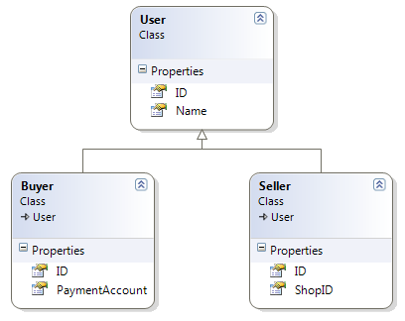
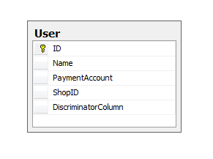
Object-relational mismatch

Slide 4
Query mismach
Linq:
session.Query<User>().Skip(20).Take(10);
SQL:
SELECT T.ID FROM
(SELECT ID,
ROW_NUMBER() OVER (ORDER BY ID) AS RowNumber
FROM Users) AS T
WHERE RowNumber > 20 AND RowNumber < 30

Slide 5
Additional layers of complexity
SQL by itself is complex
ORM add lots of additional complexity
Layer of abstraction that ORMs introduce is not complete – you often have to use “Native” SQL

Slide 6
Other relational DB limitations
Slow performance with very large tables
Limited scalability
Limited extensibility

Slide 7

No SQL introduction
There are lots of No SQL databases (MongoDB, CouchDB, Cassandra, SimpleDB, etc..), most of them are open-source and written in resent years
There are few No SQL solutions specific for .NET platform – the most popular is RavenDB

Slide 8
RavenDB installation (NuGet)
Packages available:
RavenDB Client
RavenDB Server
RavenDB Embedded
RavenDB Database
RavenDB Client MVC integration

Slide 9
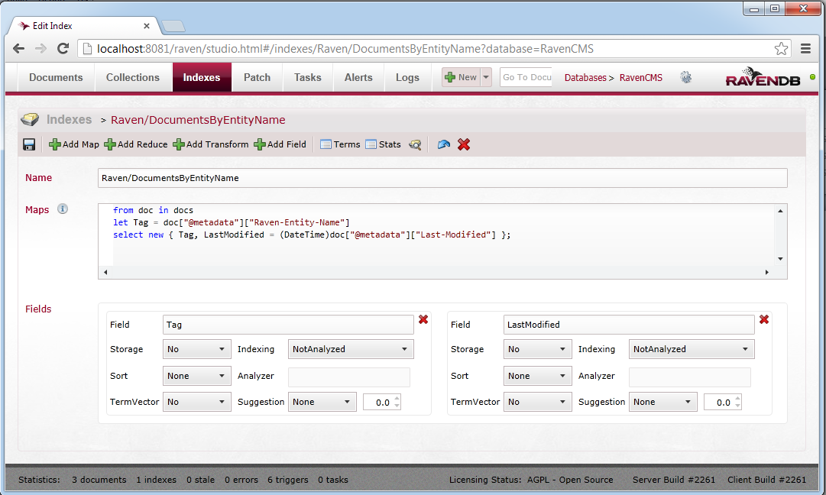
Raven Studio

Slide 10
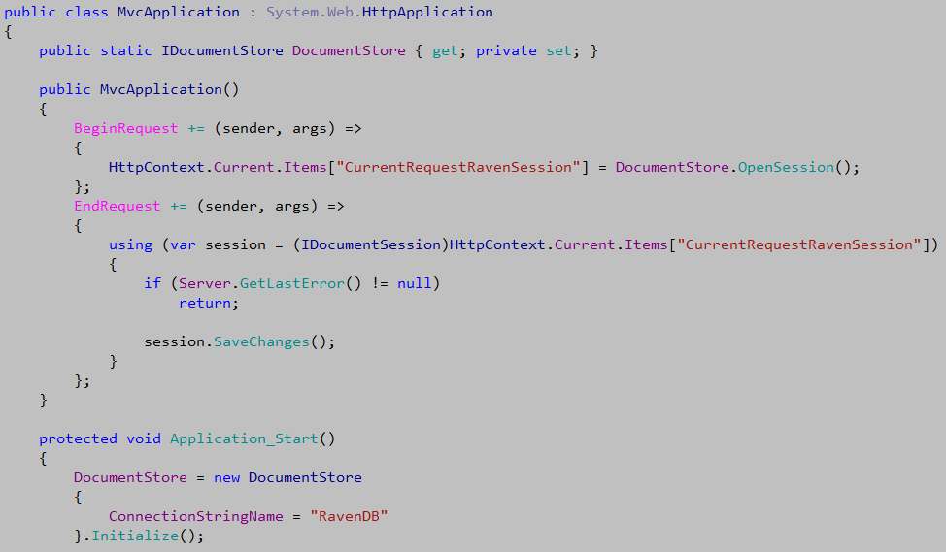
Infrastructure Setup

Slide 11
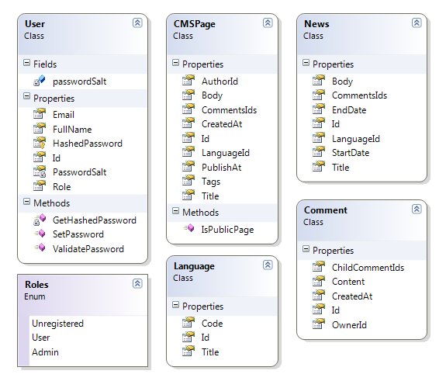
Domain

Slide 12
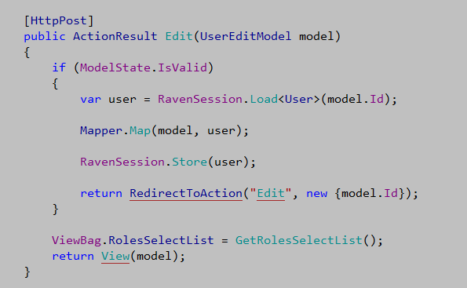
Loading and saving entity

Slide 13
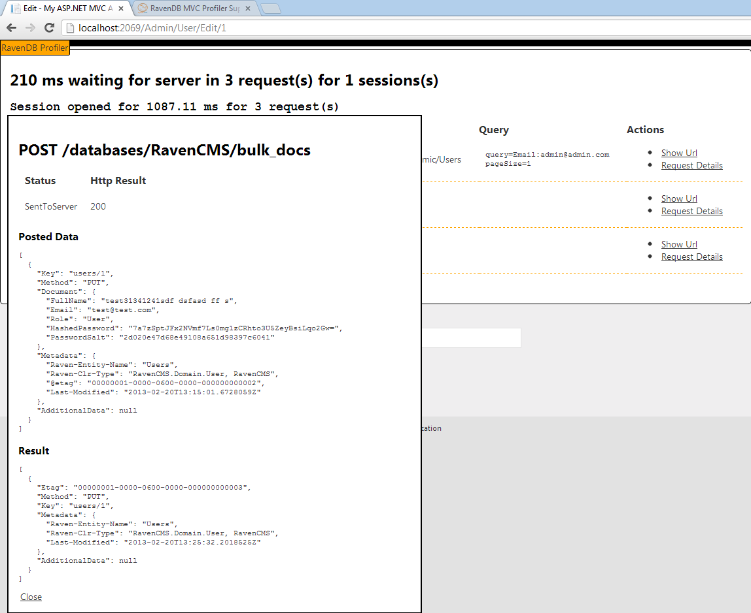
Save request details

Slide 14
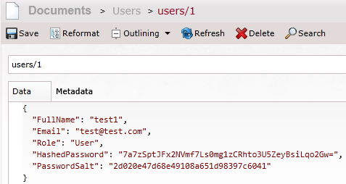
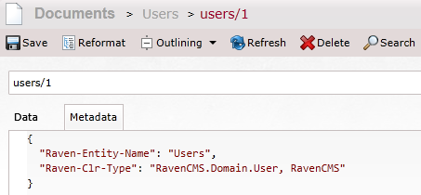
DB record details

Slide 15
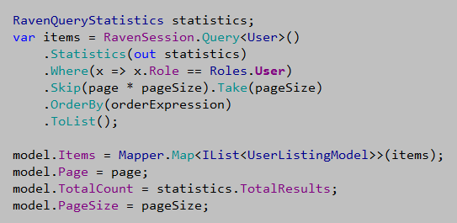
Querying

Slide 16
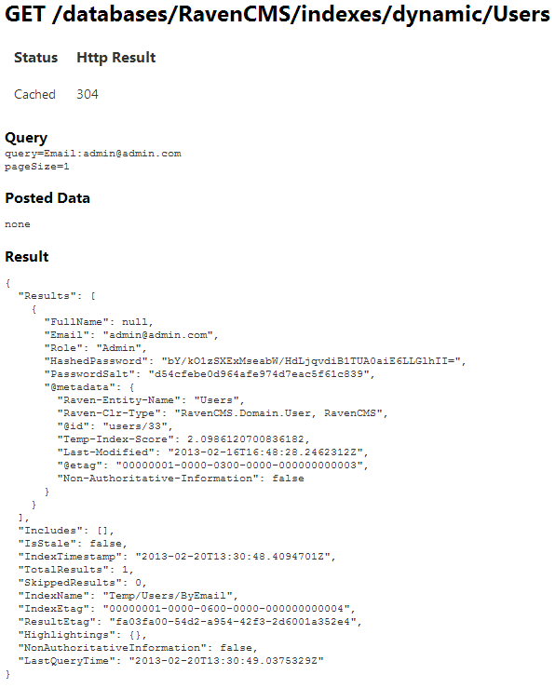
Query request details

Slide 17

А где join-ы ?!?

Slide 18
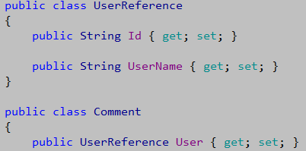
The need for joins is much lower than in relation databases
We can use deformalized references
We can use server side includes
We can use map-reduce indexes.

Slide 19
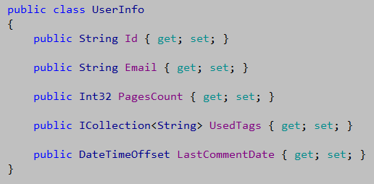
Advanced querying with indexes
DTO defenition

Slide 20
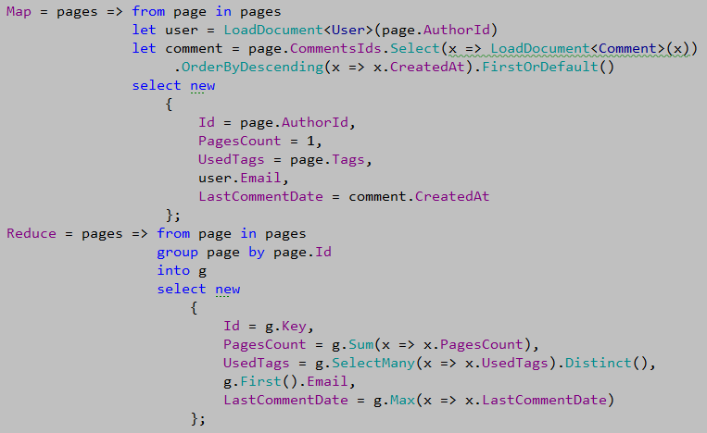
Map - reduce

Slide 21
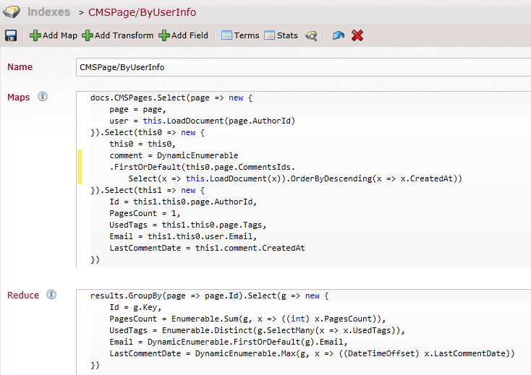
Raven internal index definition

Slide 22
Querying index

Slide 23
Eventual consistency
The CAP theorem (Brewer) states that you have to pick two of Consistency, Availability, Partition tolerance: You can't have the three at the same time and get an acceptable latency.
Consistency means that each client always has the same view of the data.
Availability means that all clients can always read and write.
Partition tolerance means that the system works well across physical network partitions.
Eventual consistency relaxes consistency for availability & partition tolerance. By doing this it also gains scalability.

Slide 24
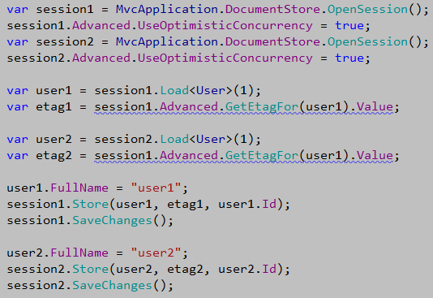
Optimistic concurrency

Slide 25
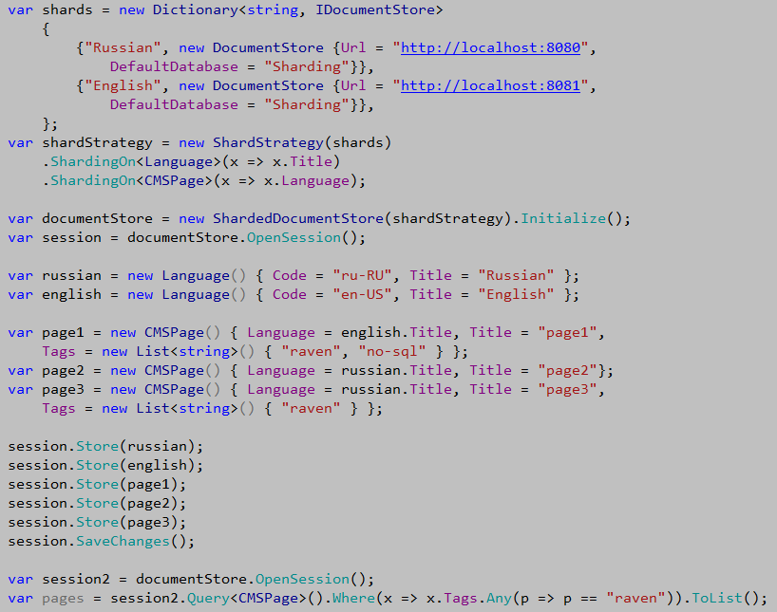
Sharding

Slide 26
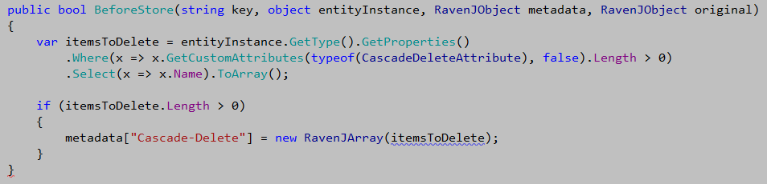
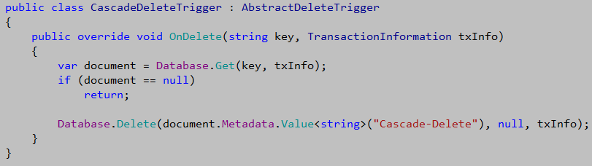
Extensibility

